Slide 1

Overview of the NVSL
Jessica Hicks
May 21, 2024

Slide 2
Director’s Office
Diagnostic Bacteriology & Pathology Laboratory
National Animal Health Laboratory Network
Diagnostic Virology Laboratory
Diagnostic Bioanalytical & Reagent Laboratory
Foreign Animal Disease Diagnostic Laboratory

Slide 3

Diagnostics
Case Load
~15,000 Accessions per year
~70,000 Samples per year
Purpose
Outbreaks
FAD Investigations
Surveillance
General Diagnostics
Import/Export
Interstate Movement
Research

Slide 4
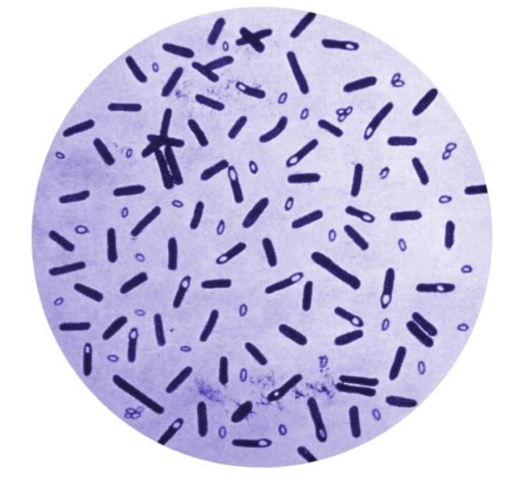
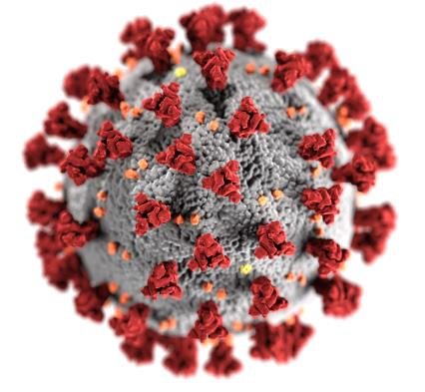
Diagnostics
Viruses
Influenza A
Avian Paramyxovirus
SARS
FMD
ASF
Eukaryotes
Haemoparasites
Ectoparasites
Intestinal parasites
Host verification
Other
Prions
Analytical chemistry
Bacteria
Tuberculosis
Brucellosis
Salmonella
Taylorella
General ID

Slide 5
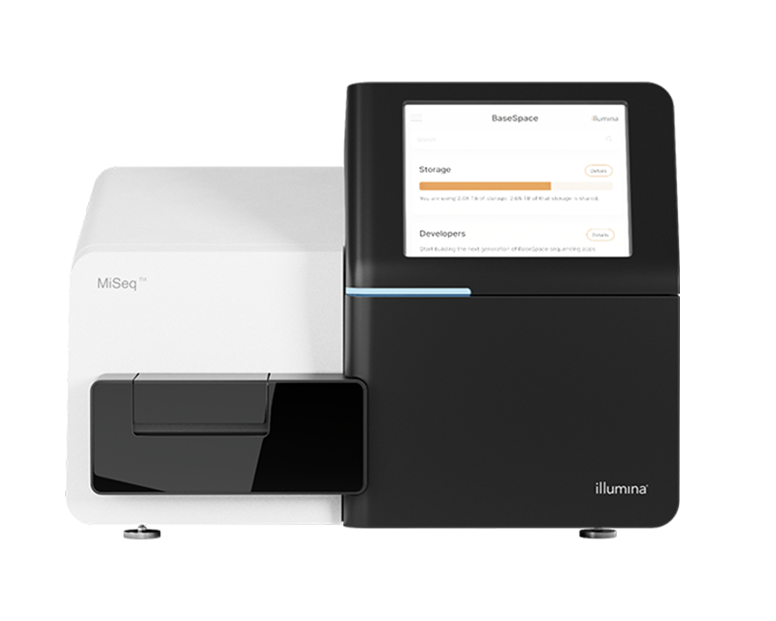
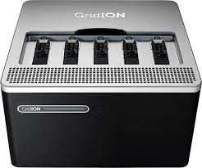
Sequencing Capabilities
Short Read
Illumina iSeq
Illumina MiSeqs
Illumina NextSeqs
Long Read
ONT MinION
ONT GridION
ONT PromethION

Slide 6
Sample Repositories
Organisms of interest
For example,
HPAI
SARS
Mycobacterium tuberculosis complex
Broad, diverse datasets
Metadata can be a problem

Slide 7
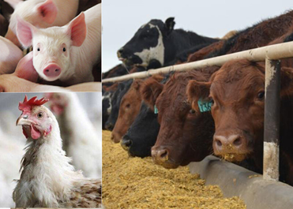
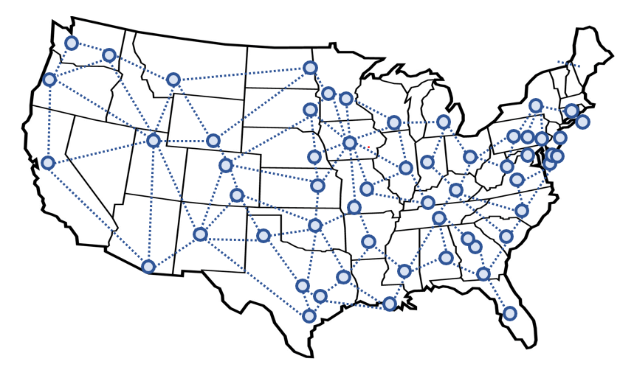
National Animal Health Laboratory Network
(NAHLN)

Slide 8
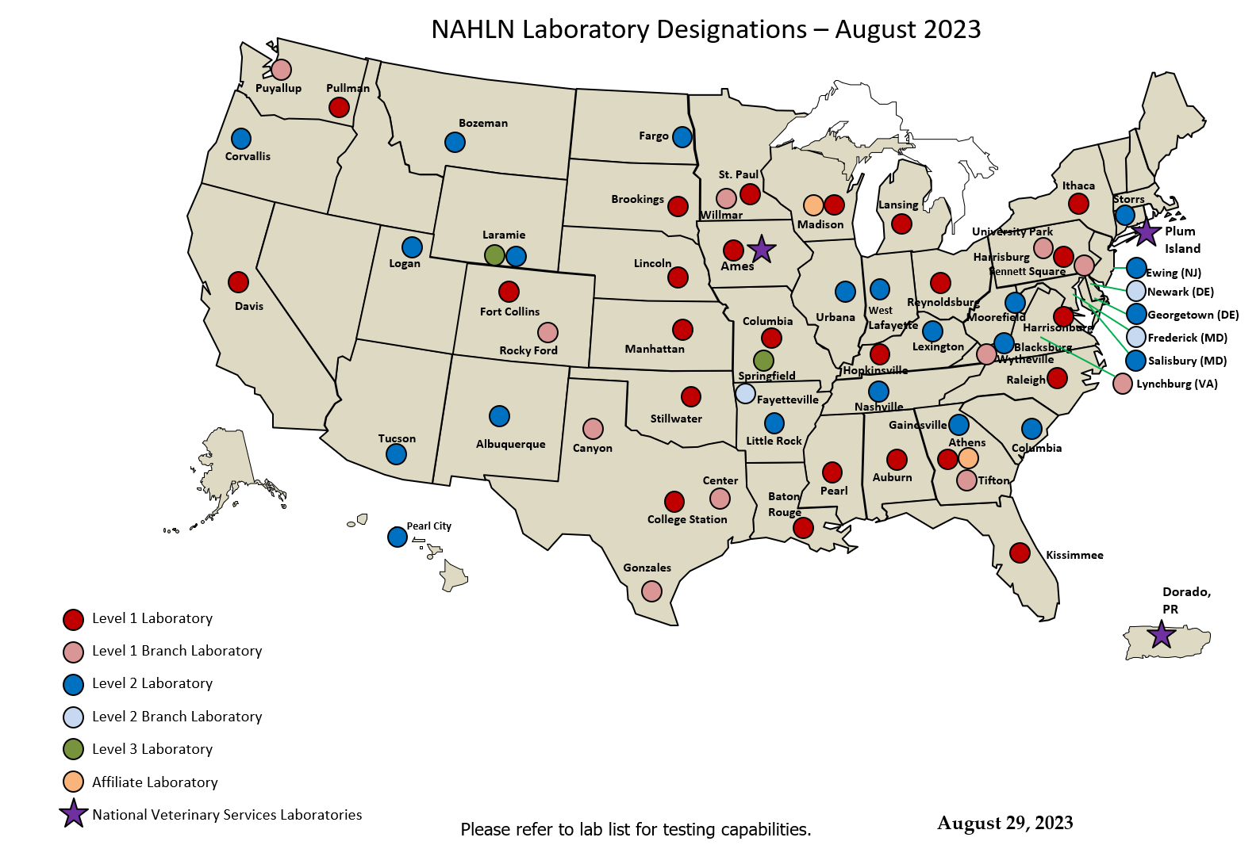
Currently there are 63 NAHLN
laboratories
in 42 states.
35 Level 1 Labs
11 Branch Labs
24 Level 2 Labs
3 Branch Labs
2 Level 3 Labs
2 Affiliate Lab

Slide 9
Current standardized methods and PTs provided by the National Veterinary Services Laboratories
African Swine Fever
Bovine Spongiform Encephalopathy
Classical Swine Fever
Chronic Wasting Disease
Foot and Mouth Disease
Influenza A Virus-Avian
Influenza A Virus-Swine
Infectious Salmon Anemia
Newcastle Disease
Pseudorabies
Scrapie
Spring Viremia of Carp
Viral Hemorrhagic Septicemia
Vesicular Stomatitis Virus
Antimicrobial Resistance
Notes:
14 Diseases under NAHLN scope that are high-consequence endemic diseases or considered Foreign Animal Diseases. Additionally we have a newly added permanent program for AMR surveillance. Very few commercially available kits that have met the requirements for use in NAHLN testing.

Slide 10
Computational Work in Genomic Epidemiology
NVSL
SNP based phylogeny with vSNP
kSNP for more distant phylogeny
Identification of specific traits
CEAH
Large scale modeling
HPAI
NAHLN AMR
Notes:
14 Diseases under NAHLN scope that are high-consequence endemic diseases or considered Foreign Animal Diseases. Additionally we have a newly added permanent program for AMR surveillance. Very few commercially available kits that have met the requirements for use in NAHLN testing.

Slide 11
Future Wish List
Improving accuracy of the models
Incorporation of phylogeography
AND/OR
Incorporation of phylodynamic diffusion models
Notes:
14 Diseases under NAHLN scope that are high-consequence endemic diseases or considered Foreign Animal Diseases. Additionally we have a newly added permanent program for AMR surveillance. Very few commercially available kits that have met the requirements for use in NAHLN testing.

